Slide 1
Employee Data Analysis using Excel
STUDENT NAME: BAAMA.S
REGISTER NO: 7792C3EA1085B45B15449E90F496E5C3,312208649
DEPARTMENT: B.COM(GENERAL)
COLLEGE: MEENAKSHI COLLEGE FOR WOMEN

Slide 2
PROJECT TITLE
Employee performance based on Gender, Department, FTE

Slide 3


AGENDA
Problem Statement
Project Overview
End Users
Our Solution and Proposition
Dataset Description
Modelling Approach
Results and Discussion
Conclusion
3/21/2024 Annual Review

Slide 4

PROBLEM STATEMENT To analyze the impact of gender, department, and full-time equivalency (FTE) status on employee performance, we aim to determine if there are significant differences in performance metrics across these variables.

Slide 5

PROJECT OVERVIEW This project aims to analyze employee performance by examining the influence of gender, department, and full-time equivalent (FTE) status. The goal is to identify patterns and potential disparities that could inform organizational strategies for improving performance across different groups.
.

Slide 6

WHO ARE THE END USERS? ● HUMAN RESOURCE DEPARTMENTS ● MANAGEMENT AND LEADERSHIP ● TEAM LEADERS AND SUPERVISORS ● EMPLOYEES ● EXECUTIVE LEADERSHIP ● BUSINESS ANALYSTS ● RECRUITERS

Slide 7

OUR SOLUTION AND ITS VALUE PROPOSITION FILTERING- REMOVE VALUES PIVOT TABLE - SUMMARY OF EMPLOYEE PERFORMANCE LINE CHART - FINAL REPORT

Slide 8
Dataset Description ● EMPLOYEE DATA SET- KAGGLE ● 9 FEATURES IN EXCEL: EMPLOYEE ID- ALPHANUMERIC(TEXT) NAME- ALPHABETICAL(TEXT) GENDER- ALPHABETICAL(TEXT) DEPARTMENT - ALPHABETICAL(TEXT) SALARY - NUMERICAL START DATE - ALPHANUMERIC(TEXT) FTE- NUMERICAL EMPLOYEE TYPE- ALPHABETICAL(TEXT) EMPLOYEE LOCATION- ALPHABETICAL(TEXT) ● 3 FEATURES USED: DEPARTMENT - ALPHABETICAL(TEXT) FTE- NUMERICAL EMPLOYEE TYPE- ALPHABETICAL(TEXT)

Slide 9

This project uniquely analyzes employee performance by integrating gender, department, and FTE, offering a multi-dimensional view that uncovers nuanced trends often overlooked in conventional performance reviews. By cross-referencing these variables, we aim to identify patterns and disparities, providing actionable insights for equitable and effective workforce management.
THE "WOW" IN OUR SOLUTION
3/21/2024 Annual Review
9

Slide 10
MODELLING
● STEP -1
DOWNLOAD THE EMPLOYEE DATASET AND OPEN THE EMPLOYEE DATASET IN EXCEL.
● STEP -2
SELECT THE ENTIRE DATA AND CLICK ON DATA AND CLICK ON FILTER OPTION.
● STEP -3
FILTER FTP FROM A TO Z ORDER.
● STEP -4
SELECT THE ENTIRE DATA AND CLICK ON INSERT AND CLICK ON PIVOT TABLE TO
CREATE PIVOT TABLE.
10

Slide 11
● STEP -5
DRAG THE NEEDED DATA AND CREATE A PIVOT TABLE.
● STEP -6
SELECT THE PIVOT TABLE AND CLICK ON INSERT.
● STEP-7
NOW CLICK ON THE CHART THAT YOU WANT.
● STEP -8
THE CHART IS CREATED.

Slide 12
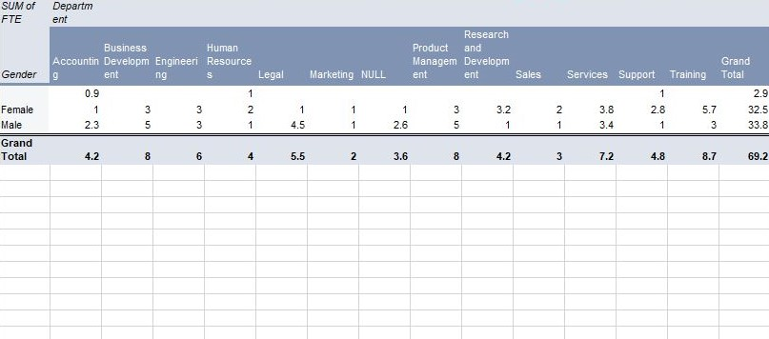
RESULTS 1.TABLE
12

Slide 13
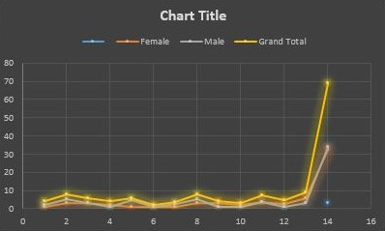
2.LINE CHART

Slide 14
Conclusion The analysis suggests that employee performance varies more significantly by department and FTE status than by gender, indicating that departmental roles and work hours may have a greater impact on performance outcomes. Gender does not appear to be a primary determinant of performance across the data examined.

